Slide 1
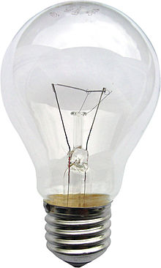
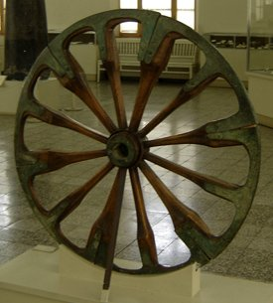
PROGRESS AND DEVELOPMENT
Conditionals

Slide 2
First conditionals
First | If- PRESENT SIMPLE | , FUTURE SIMPLE
If the weather is fine, we will go to the countryside.

Slide 3
Second conditionals
Second | If- PAST SIMPLE | , FUTURE IN THE PAST
If I were rich, I would help the poor animals.

Slide 4
Third conditionals
Third | If – PAST PERFECT | , would(could) have+V3
If people hadn’t thrown waste in the water, our seas would have been cleaner.

Slide 5
Mixed conditionals
Mixed | If- PAST PERFECT | , FUTURE IN THE PAST
If the Maya had predicted weather changes better, their civilization would survive today.

